Slide 1

TS -CAPSTONE PROJECT
ENGLISH DICTIONARY
Presented by:
B. Deepika
B. Visalakshi
p.joharika
Guided By:
Umamaheswari

Slide 2

outline
Abstract
Introduction
Problem Statement
Objective
Benefits
Steps for English dictionary

Slide 3
Abstract
The English dictionary app consists of a search text field and a search button. The user has to enter the word in the text field and click on the search button. The result displays the word meaning ,word pronunciation audio clip. It also displays word usage for appropriate words.

Slide 4

Introduction
A dictionary is used as a tool for referencing. It is used to look up meaning for a word or might also be used to look up the pronunciation of that word.
Nowadays there are a lot of dictionary being produced worldwide. These dictionaries could be found in all bookstores in various sizes.

Slide 5
Problem statement
Dictionaries on mobile devices are more practical then conventional dictionaries, as users can receive information quickly anywhere without space and time constraints.
This application built to help and meet the needs of the students to searching for meaning and understand various English words.

Slide 6

Objective
This application is built to help & meet the needs of students, teachers or anyone across the word searching for meaning of words. It makes them understand various English words quickly & improve their language

Slide 7
Benefits
Easy to find out the meaning of a word.
Very and easy to handle for the user.
To introduce a well GUI based interface.
A good dictionary can help you understand your subject better, improve
your communication and improve your grades.

Slide 8
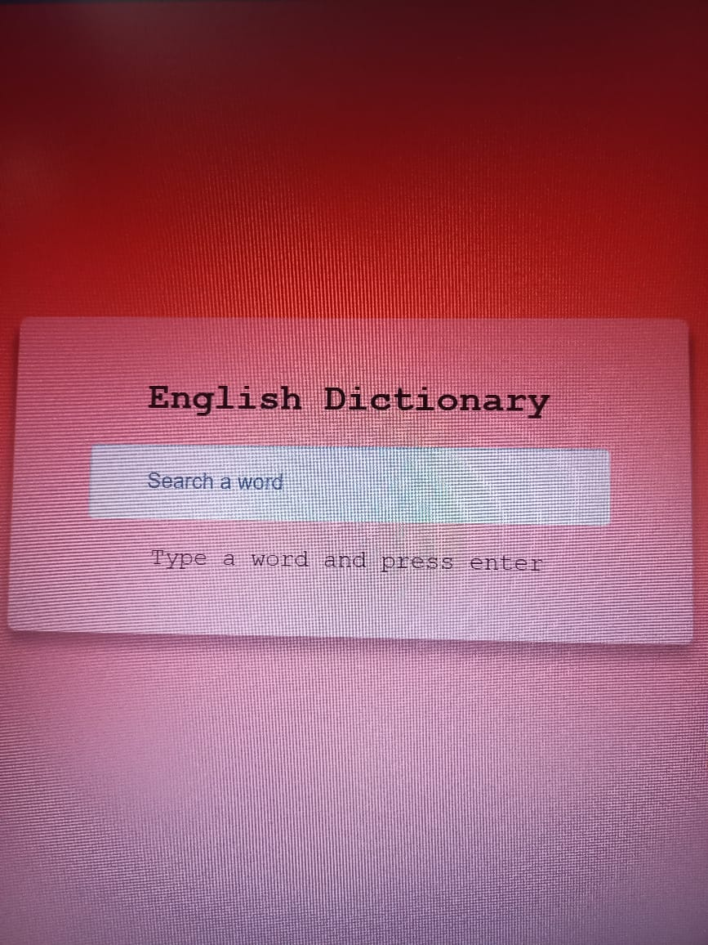
Steps for English Dictionary

Slide 9
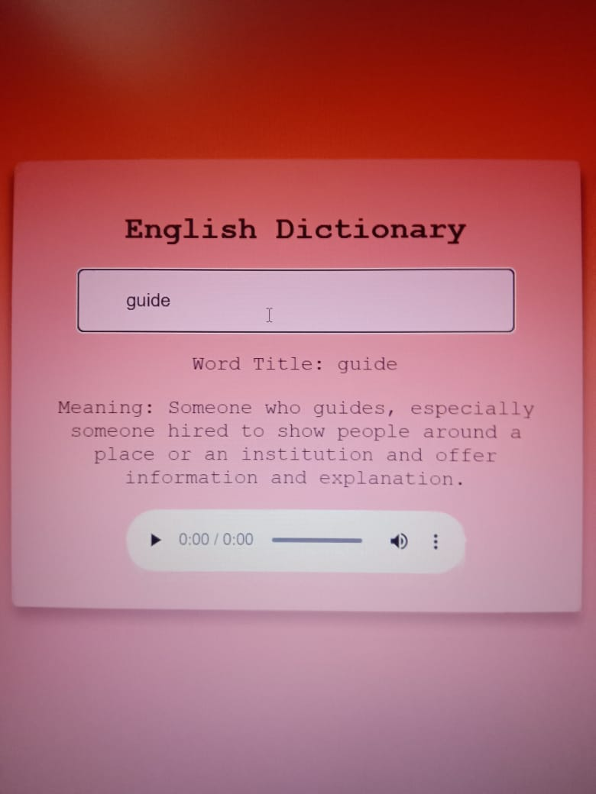
.

Slide 10
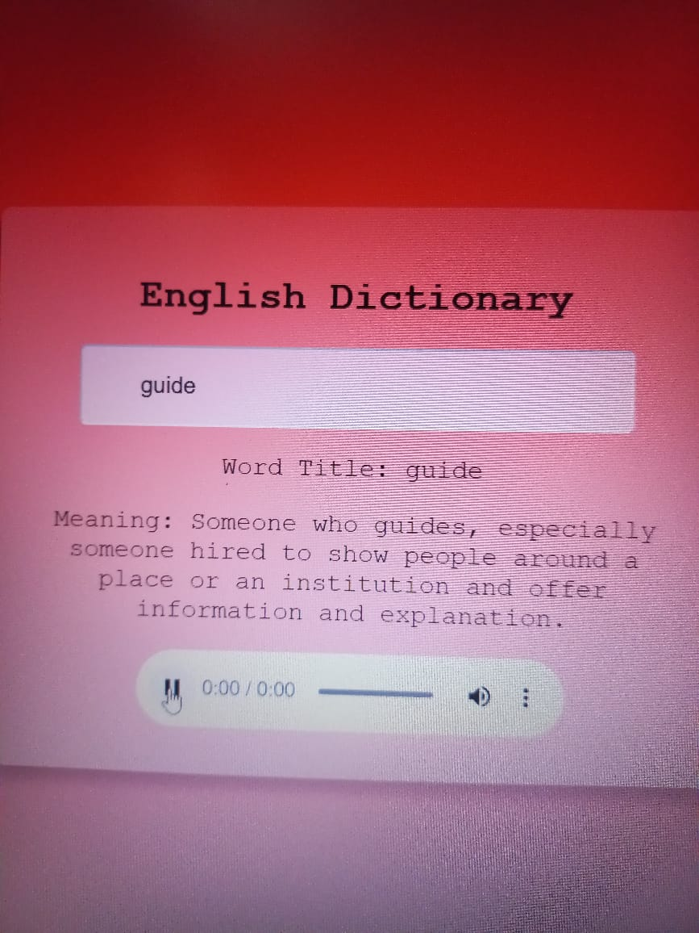

Slide 11

.

